Slide 1


Histopathological Classification
Joanna Wiekiera, Martyna Żur

Slide 2

INPUT DATA
Aim of this project is to distinguish five classes:
colon benign tissue
colon adenocarcinoma
lung benign tissue
lung adenocarcinoma
lung squamous cell carcinoma

Slide 3
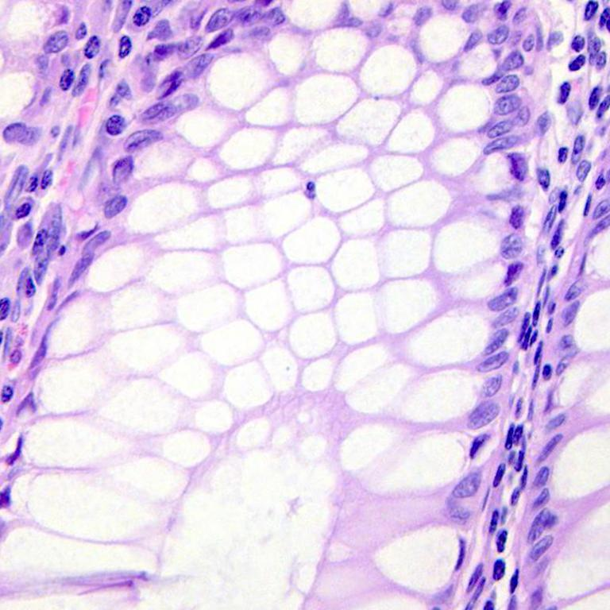
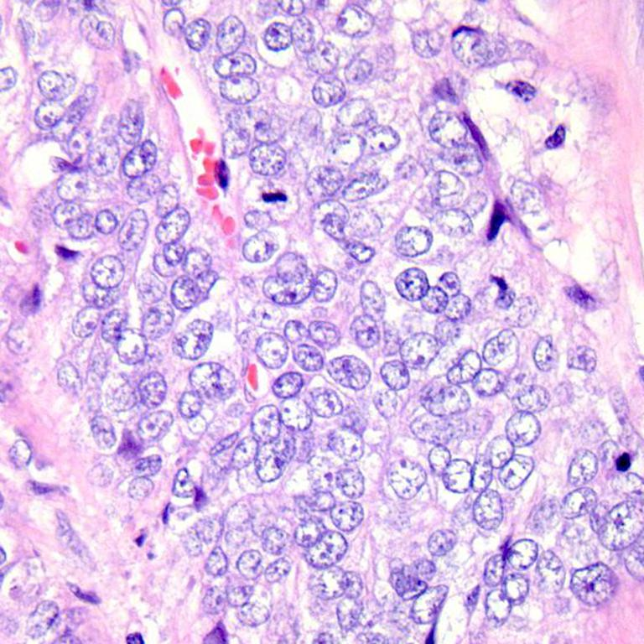
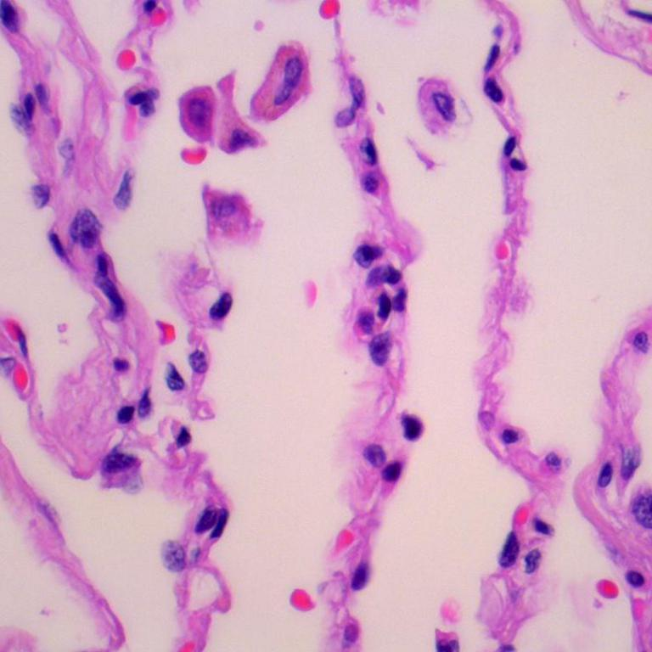
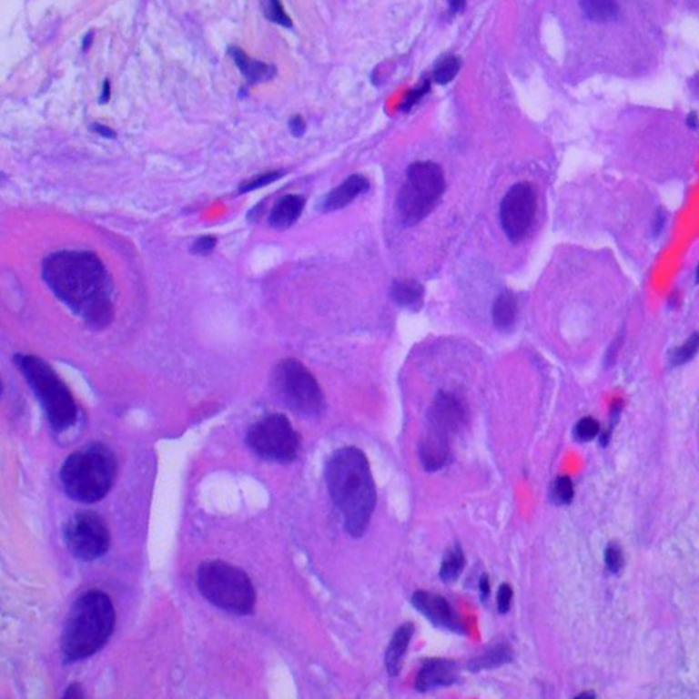
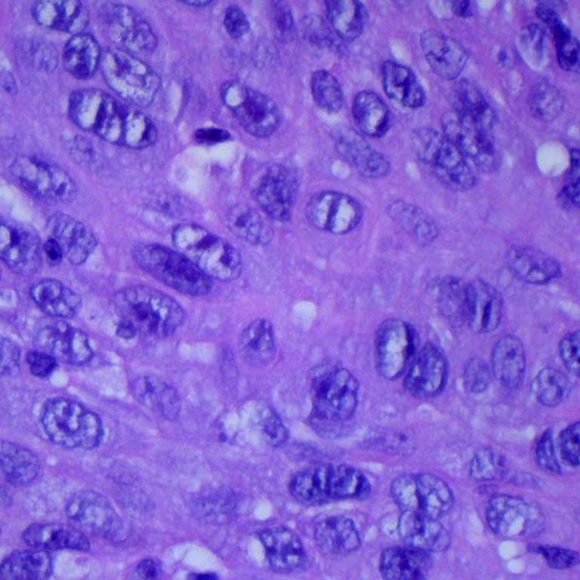
INPUT DATA
Aim of this project is to distinguish five classes:
colon benign tissue
colon adenocarcinoma
lung benign tissue
lung adenocarcinoma
lung squamous cell carcinoma
(1) colon benign tissue
(2) colon adenocarcinoma
(3) lung benign tissue
(4) lung adenocarcinoma
(5) lung squamous cell carcinoma

Slide 4
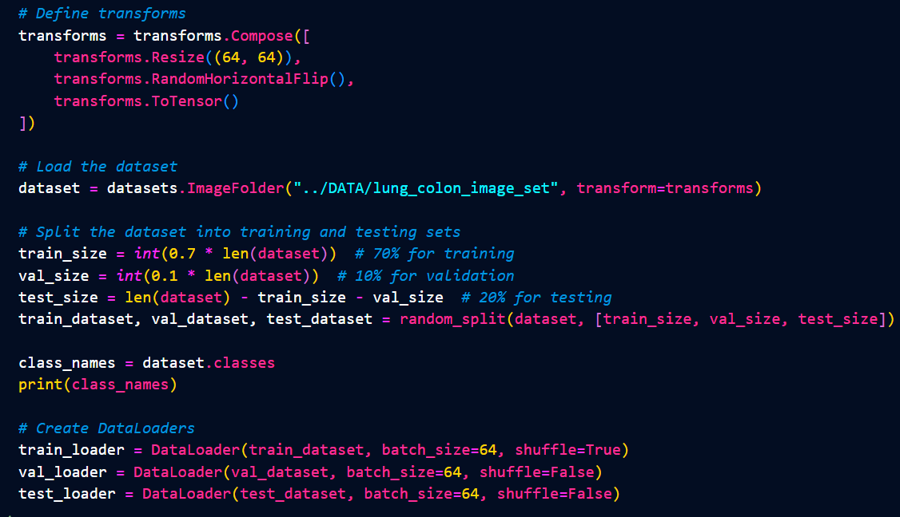
DATA PREPROCESING

Slide 5
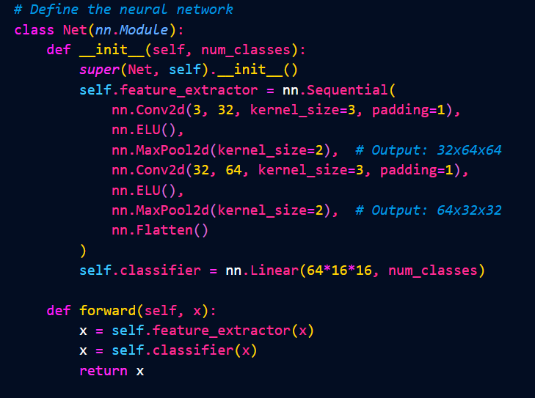
(1)
CONVOLUTIONAL NEURAL NETWORK
(1)

Slide 6
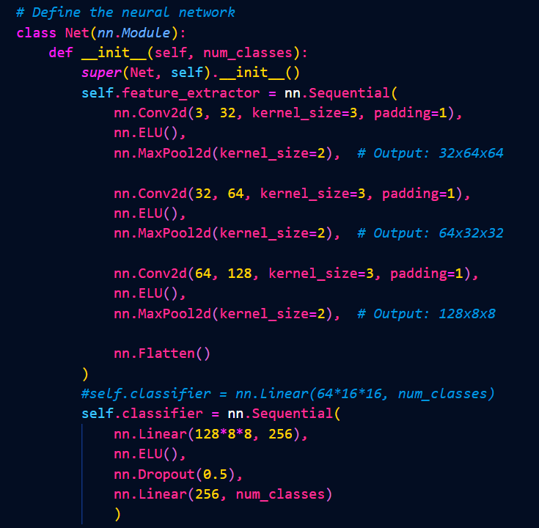
CONVOLUTIONAL NEURAL NETWORK
(2)

Slide 7
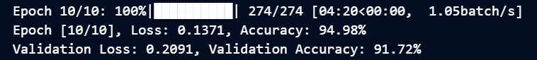
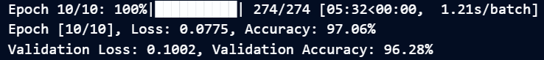


CONVOLUTIONAL NEURAL NETWORK
(3)

Slide 8
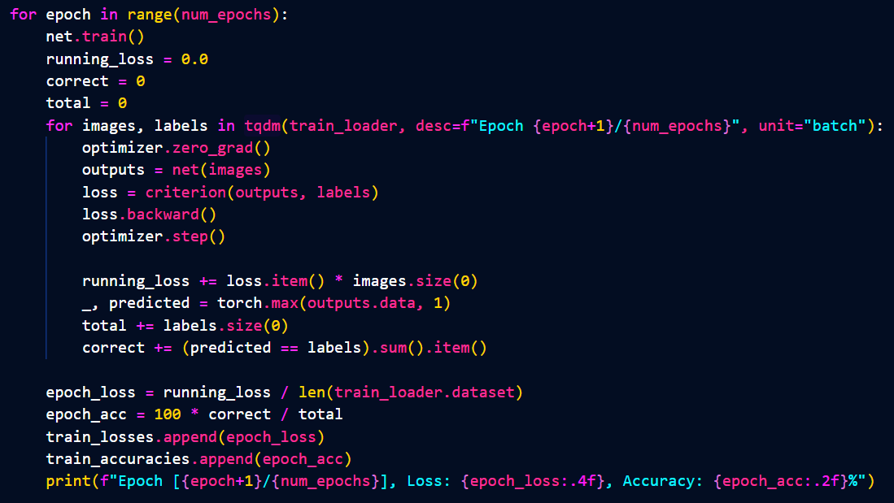
TRAINING LOOP (traning)

Slide 9
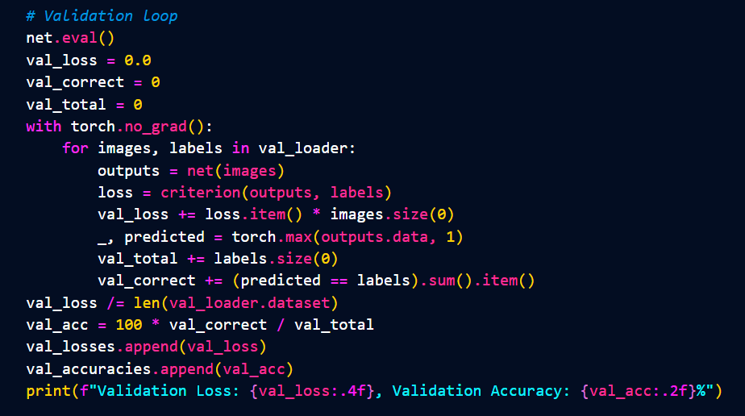
TRAINING LOOP (validation)

Slide 10
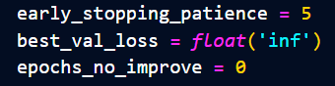
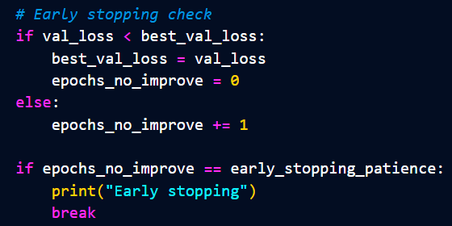
TRAINING LOOP (early stopping)

Slide 11
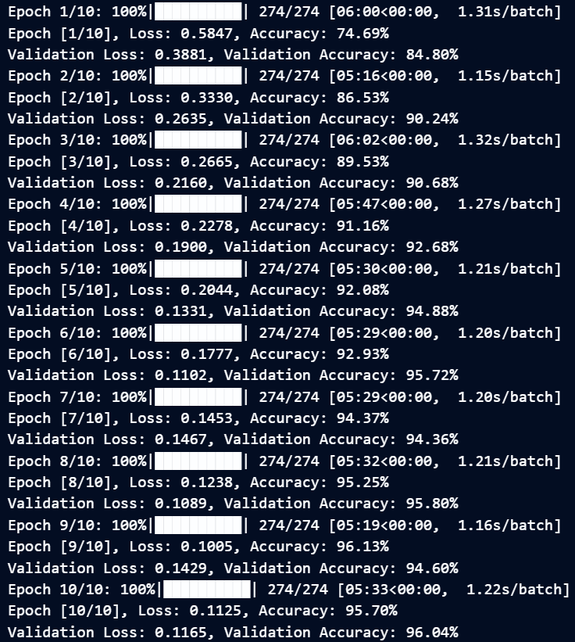
RESULT
(tqdm)

Slide 12
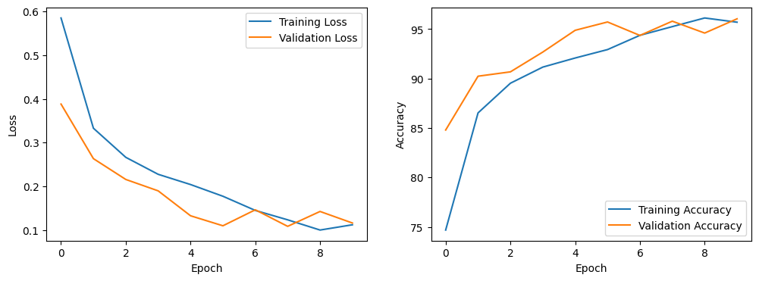
RESULT (plots)

Slide 13
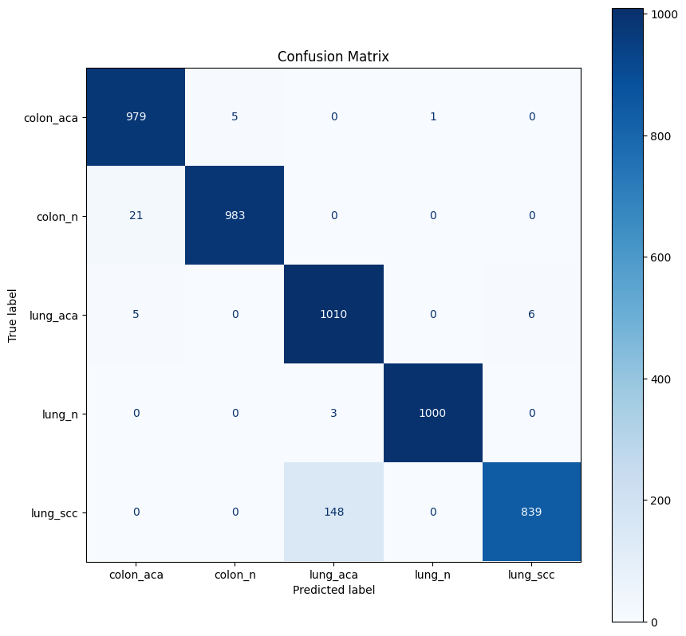
RESULT
(confusion matrix)

Slide 14
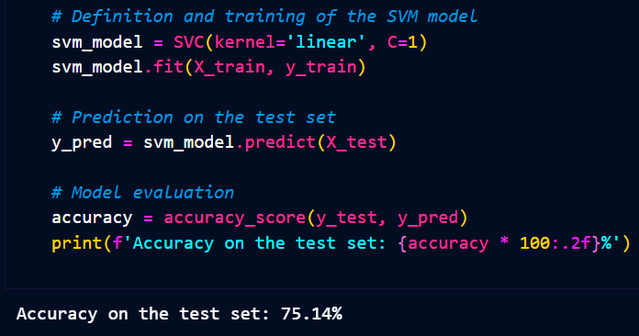
Support Vector Machine

Slide 15
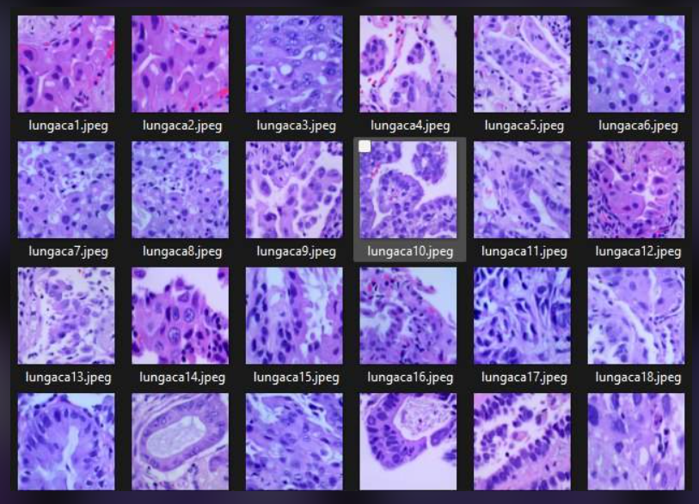

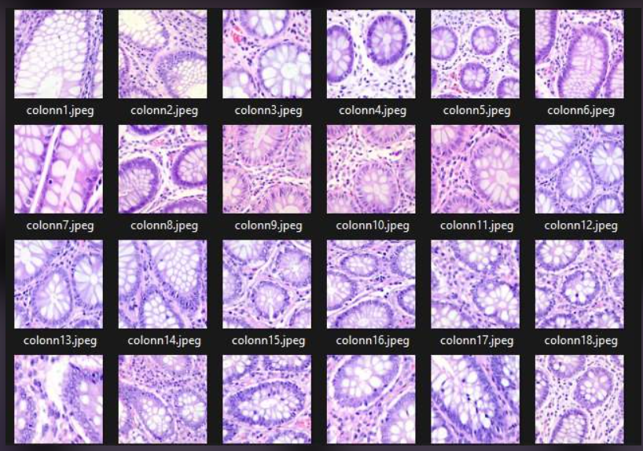
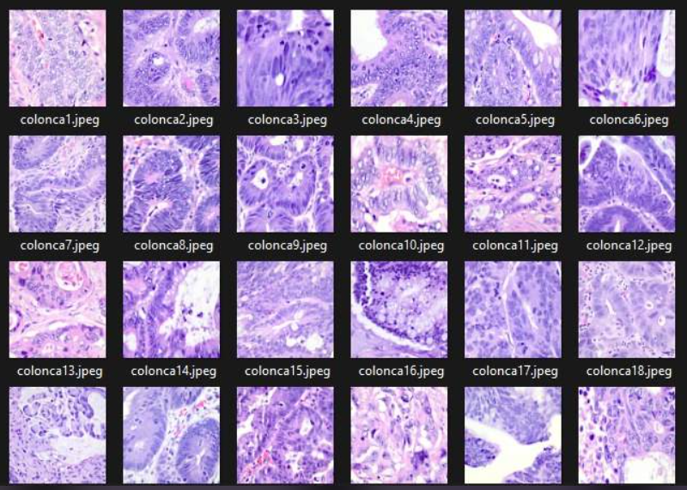
CONCLUSION
OUR DATE:
Training loss
Validation loss

Slide 16
Histopathological Classification
Joanna Wiekiera, Martyna Żur

